Slide 1
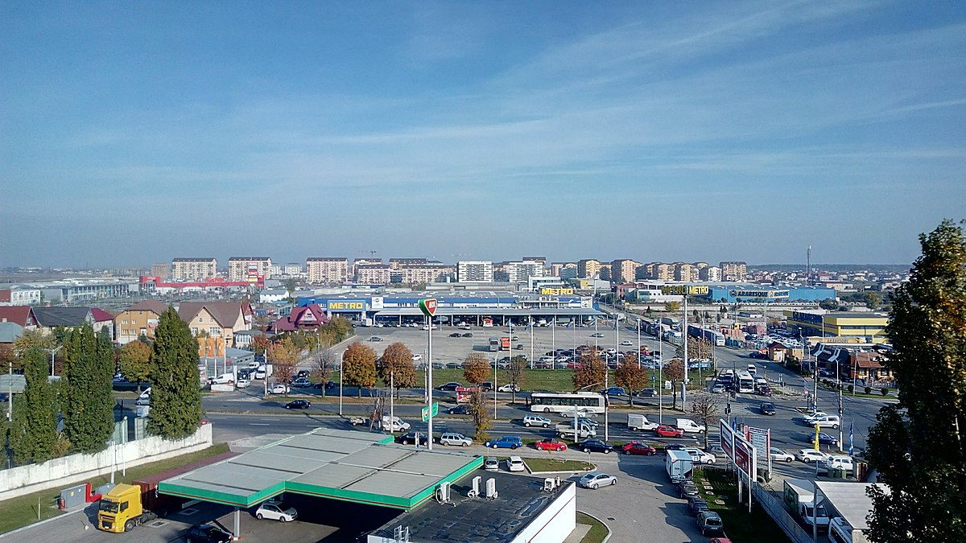
Industrial property for sale
/ BUCHAREST – MILITARI AREA
January 2019

Slide 2
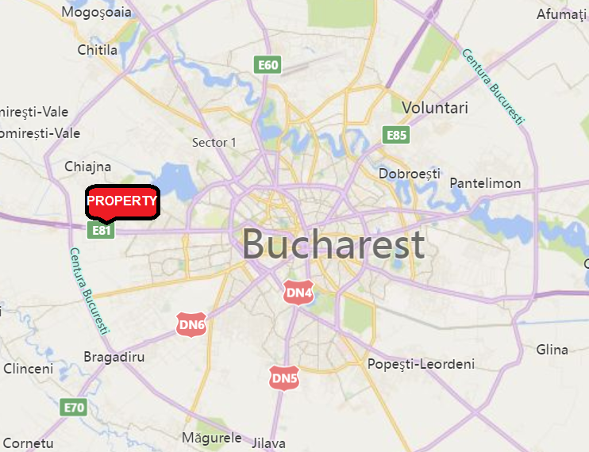
PROPERTY INFO
The property is located in a mixed use, highly attractive location on 44-50 Drumul Osiei street, 6th district, Bucharest, on a plot of land of 17,824 sqm. Large office developments (West Gate), residential (Militari Residence) and commercial developments in walking distance (Military Shopping Center, Metro, Arabesque)
The property consist in:
Administrative / office building: usable surface of 2,330 sqm plus terraces and basement of another 530 sqm
Warehouse: usable surface of 3,123 sqm out of which 156 sqm of offices and restrooms
Excess land of aprox 4,500 sqm
Administrative building
(sqm)
Office
Other areas
Total area
Ground floor
860
17
877
1st floor
809
5
813
2nd floor
410
352
761
Basement
251
157
408
Total
2,330
530
2,860
Warehouse
(sqm)
Deposit
Office
Total area
Ground floor
2,966
68
3,035
1st floor
88
88
Total
2,966
156
3,123
Excess land
4500
sqm

Slide 3
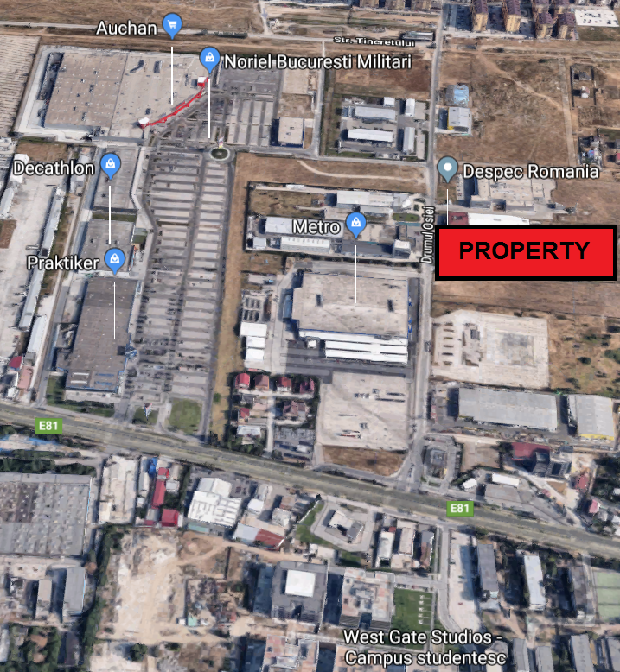
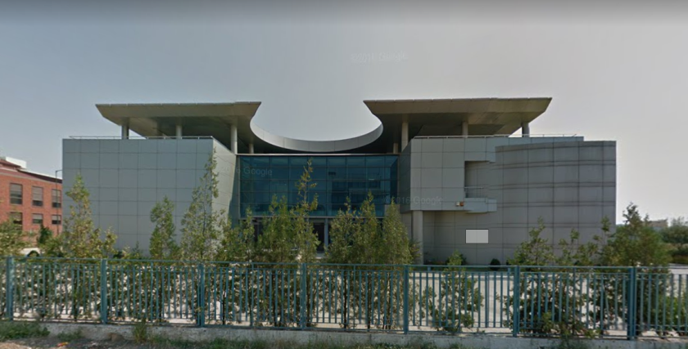
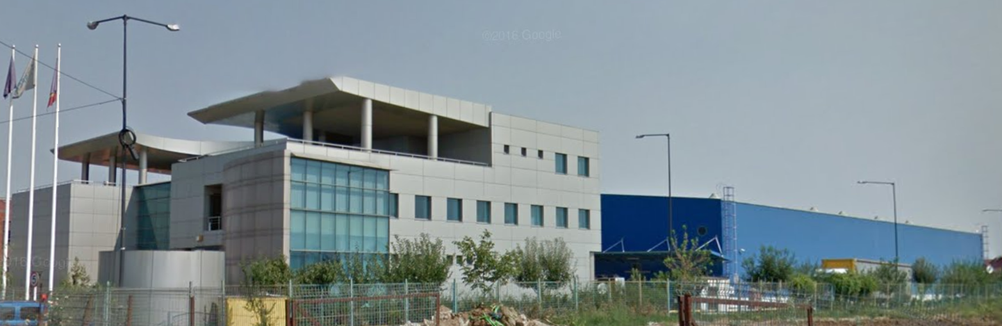
PROPERTY DETAILS
Land: 17,824 sqm
Used land: 13,324 sqm
Free land: 4,500 sqm
Access:
Preciziei Metro station: 1 km
Iuliu Maniu road: 350 m
Bus: 178 (at 200 m), 62, 137, 138, 236 (at 400 m)
Frontage:
66 m
2nd access in the back
Utilities:
gas, swage, electricity, water
Urban Planning:
According to PUG: M3 (mixed use; up to P+4; POT 60%
CUT 2.5)
Use:
Industrial (logistic / production)
Offices
Excess land for warehouse expansion / residential
development

Slide 4
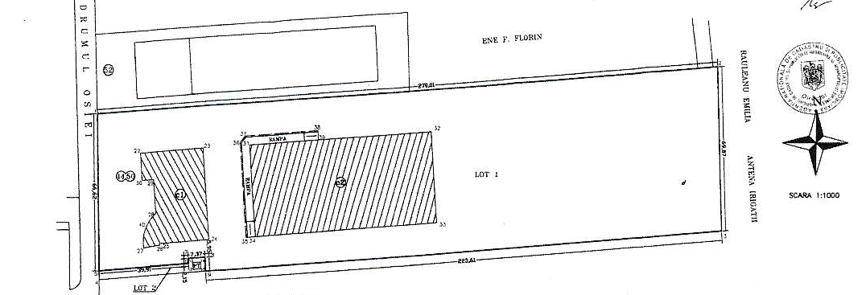
SITE PLAN
WAREHOUSE
3,123 sqm
ADMINISTRATIVE BUILDING
2,860 sqm
FREE LAND
4,500 sqm

Slide 5
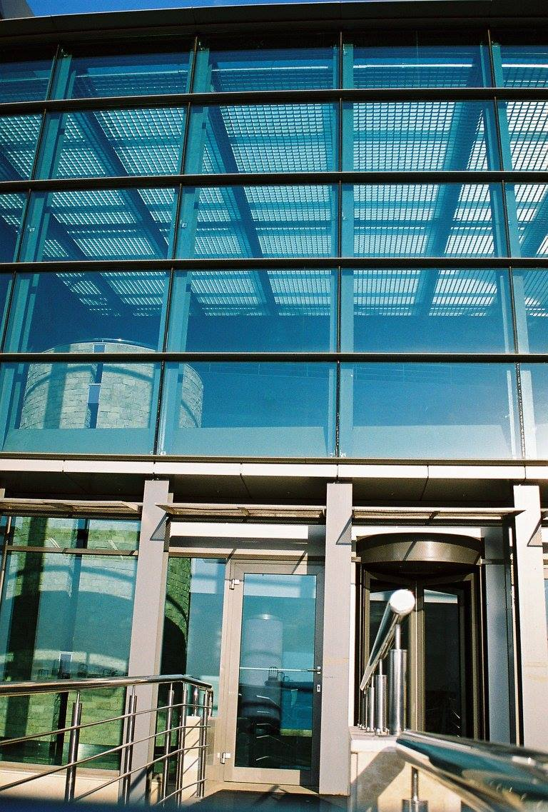
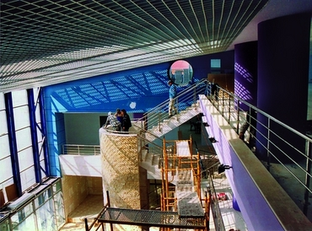
TRANSACTION STRUCTURE
SCENARIOS
Bulk asset sale
Empty property
or
50% leased by former owner
2. Partial asset sale
Administrative building
and / or
Warehouse
and / or
Free Land
* Sale and payment in installment can be considered

Slide 6
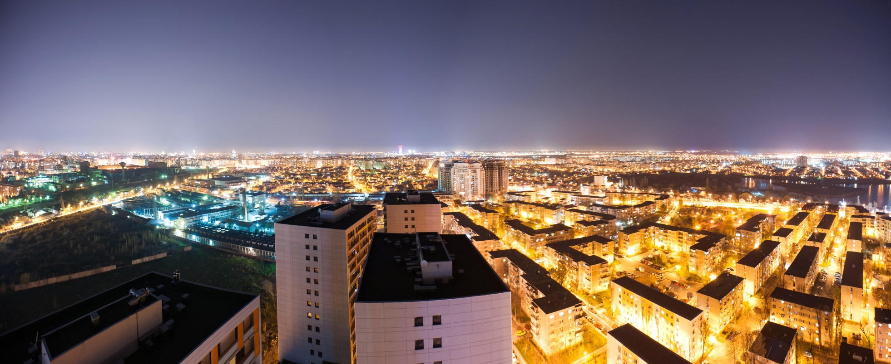


ALPHA REAL ESTATE SERVICES SRL
Disclaimer:
The present investment proposal was prepared by Alpha Real Estate Services (ARES) as appointed broker for the sale of the property. The proposal is based mostly on information received from the owner but we do not assume liability for the accuracy of its content.
The proposal does not represent a legally binding agreement under any law, neither a commitment nor a firm offer.
For more information please contact us as:
1B Pipera road, Cubic Center, 5th floor, Voluntari, Ilfov
021.455.7353
office@ares-pm.ro
www.imobiliareares.ro

